Slide 1
COMPUTER SCIENCE PROJECT II-CS692
CLASS NAVIGATOR GUIDANCE BY-PROF HENRY WONG
Our GitHub Link-
https://github.com/CS691team3/CS691team3project
Our Wiki page link-
https://github.com/CS691team3/CS691team3project/wiki
Team Members
1. Shivam Mattoo
2. Ameya Kherodkar
3. Chinmay Joshi
4. Kenneth Okereke
5. Ashutosh Misar

Slide 2
Introduction
Class navigator is an app which will navigate students ,faculty, visitors to their respective destinations in university campus
It navigates users within the school facility using certain images
It will be a cross platform mobile application
This app will provide elegant, aesthetically pleasing panoramic tour to our university

Slide 3


Sprints
Sprint 1
UI development and Gathering images and Videos
Sprint 2
Extracted images from videos , trained dataset and developed application to provide path search implementation
Sprint 3
Implemented backend using SQLite with our application to store the date in database
Implementing DCNN trained model with our application along with database to deploy final version of our project
Sprint 4

Slide 4
SPRINT 3
Developed Backend for our Application using SQLite in Android Studio.
Storing Trained Data Sets in Backend for Image Recognition
Integrated Backend with our Application for both iOS and Android.
Adding Augmented Reality to our application

Slide 5

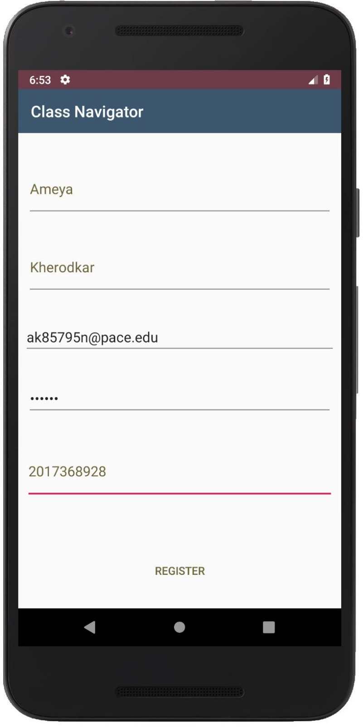
Sprint1 USER STORY: 1 Sign-Up Module | Completed Story Points: 2 As a First time user I must be able to successfully signup for the application so I can login into my application
ACCEPTANCE CRITERIA
Enter Valid Username Enter valid Email Enter valid Password Enter valid Contact Number

Slide 6
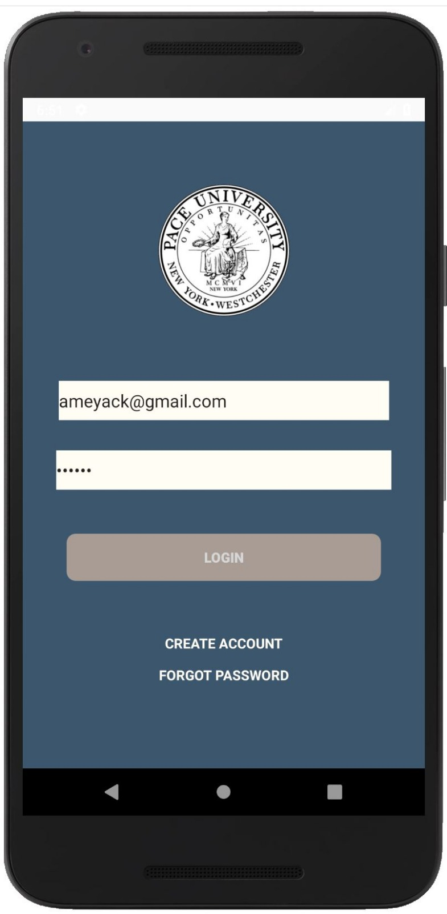
Sprint 1 User Story: 2 Login Module | Completed Story Points: 2 As a Valid user I must be able to successfully login into the Application so I can Start using my application
ACCEPTANCE CRITERIA
Login with valid Username/Email Enter valid Password Login

Slide 7
Sprint 1 User Story: 3 Forgot Password Module | Completed Story Points: 2 As a Valid user I must be able to successfully retrieve my password so I can login into my Application
ACCEPTANCE CRITERIA
Enter valid Username/Email

Slide 8
Sprint 1 User Story: 4 Logout Module | Completed Story Points: 2 As a Valid user I must be able to successfully logout so I can go back to login screen and login again with same or different account
ACCEPTANCE CRITERIA
Press logout

Slide 9
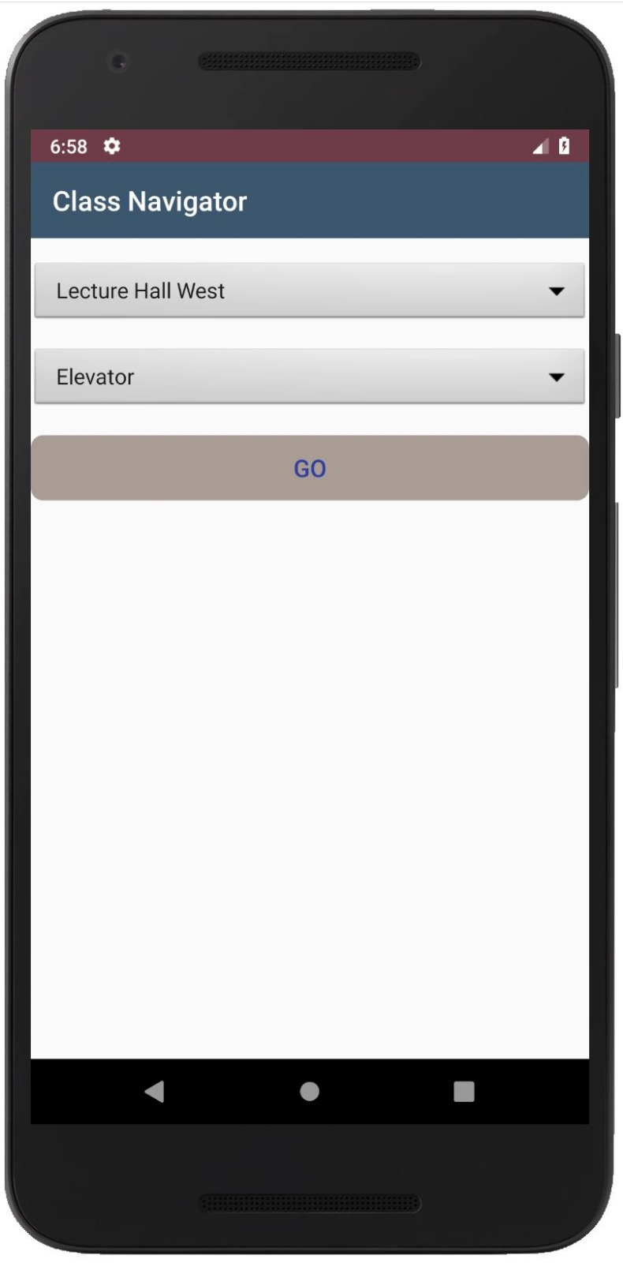
Sprint 2 User Story: 5 Selection Module | Completed Story Points: 2 As a Valid user I must be able to successfully Select my Starting and final location so I can search for my destination
ACCEPTANCE CRITERIA
Valid start location valid destination

Slide 10
SPRINT 2 User Story: 6 Trained Dataset Module | complete Story Points: 3 As a developer I must able to successfully train and label images so I can help in image recognition
ACCEPTANCE CRITERIA
Valid dataset valid labelled images

Slide 11
SPRINT 3 User Story: 7 camera Module | Complete Story Points: 3 As an application developer I must able to open camera application upon clicking go so I can help user navigate to his destination
ACCEPTANCE CRITERIA
Valid source location Valid destination location

Slide 12
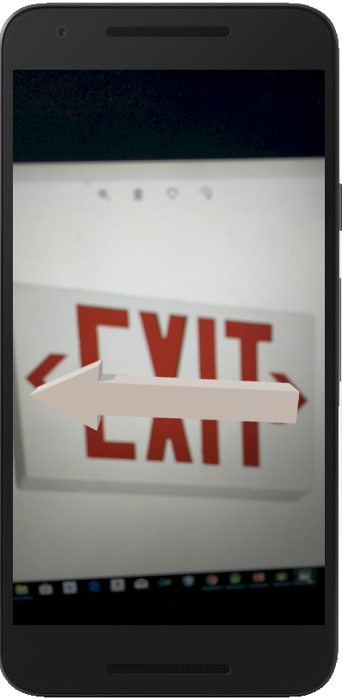
SPRINT 3 User Story: 8 AR Module | Complete Story Points: 3 As a user, I must able to see AR objects so it can point me towards the right direction
Application CRITERIA
Clear object

Slide 13
SPRINT 3 User Story: 9 Search Module | Incomplete Story Points: 3 As a Valid user I must able to get directions so I can successfully reach to destination from source/ start location
ACCEPTANCE CRITERIA
Valid source location Valid destination location

Slide 14
SPRINT 4 User Story: 10 database Module | Incomplete Story Points: 3 As a developer I must able to successfully store and retrieve data and images so I can help in maintain records, authentication and image recognition
APPLICATION Criteria
Source and destination should not be same

Slide 15
Upcoming Implementation (Sprint 4)
Completing Training Dataset
Completing Backend for our Application
Minor Upgrades to Application
Integration Testing
Project deployment

Slide 16
Test Cases
Test Case Id | Test case Name | Test case description | Expected Result
1. | User Registration/signup | New Users click on signup to be redirected to signup page | Users get redirected to signup page
2. | Creating Account | User enters account information like name, email, phone number, username and password | Signup complete
3. | Phone number | User enters numbers | Phone number accepted
4. | Phone number | User enters characters | Please enter a valid phone number
5. | Password | User enters a password less than 6 digits | Please enter a password 6 digits or greater
6. | Login | User enters correct username and password | Login successful user gets redirected to his account

Slide 17
Test Cases
Test Case Id | Test case Name | Test case description | Expected Result
7. | Login | User enters incorrect username or password | Login failed please try again
8. | Search | User clicks on the search button | Camera Opens
9. | Log out | User selects log out | Successfully logged out redirected to login page

Slide 18
Steps we use to extract images from videos
Video fisheye distortion correction for all videos, and convert video format to 480p@30fps
Extract images from all frames of the video and rescale to 256×256;
Remove low quality images with blur indicator less than 0.45
Randomly split the dataset into two: 300 images from each category as validation dataset, and use the rest as training dataset

Slide 19
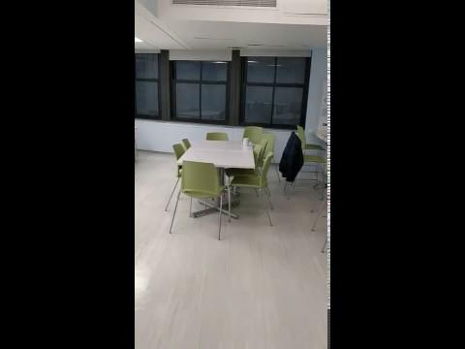
Sample Video to extract images

Slide 20
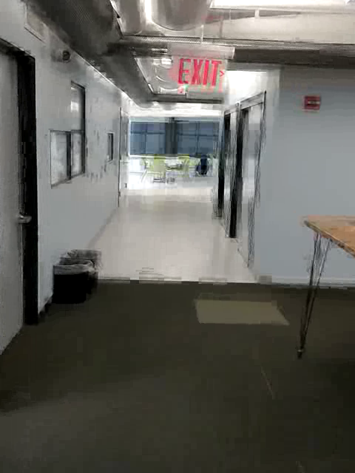
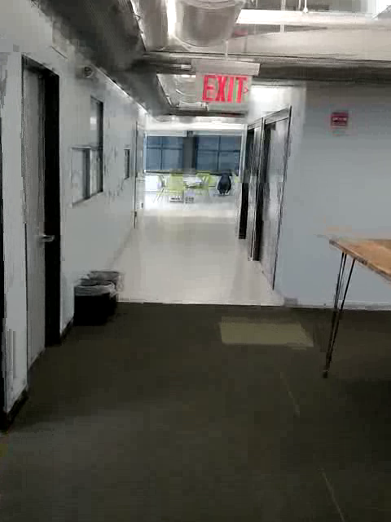
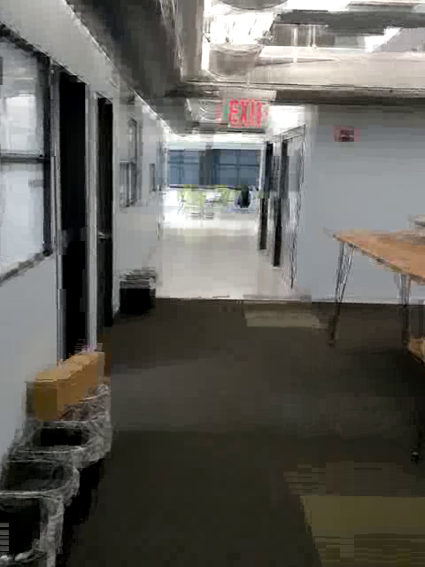
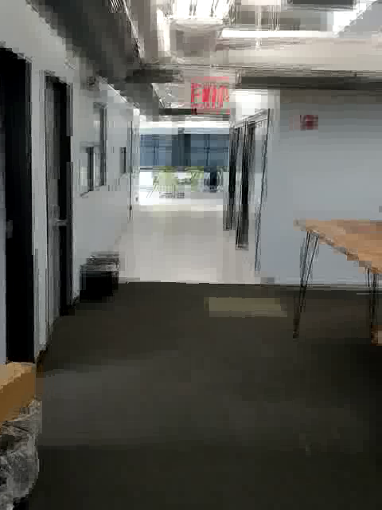
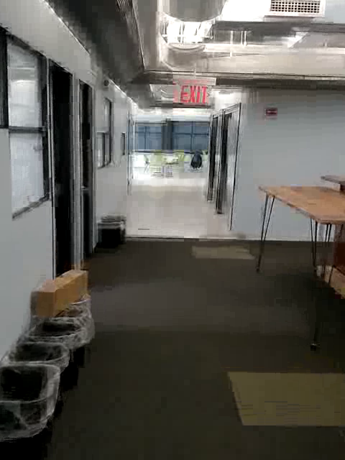
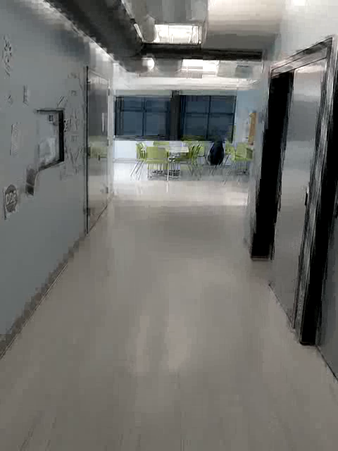
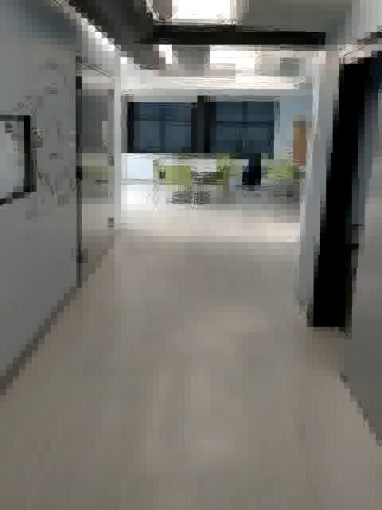
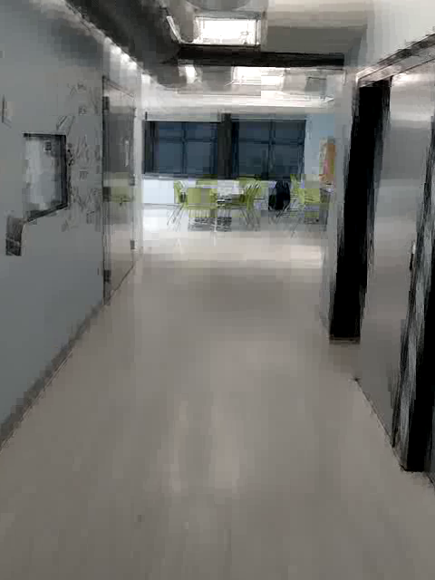
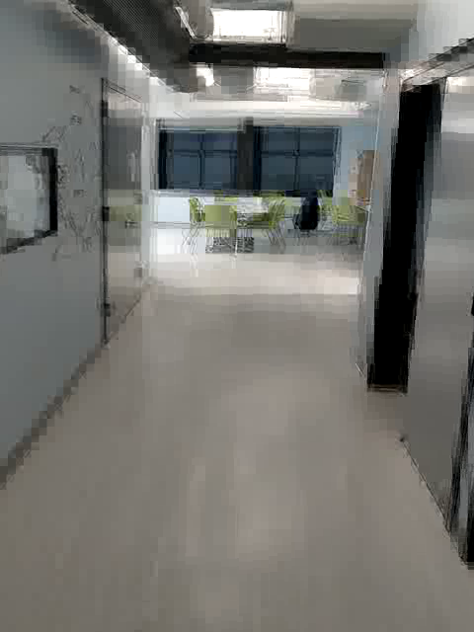
Sample Images Extracted and labeled
Kitchen 01 - 05
Kitchen 06- 09

Slide 21
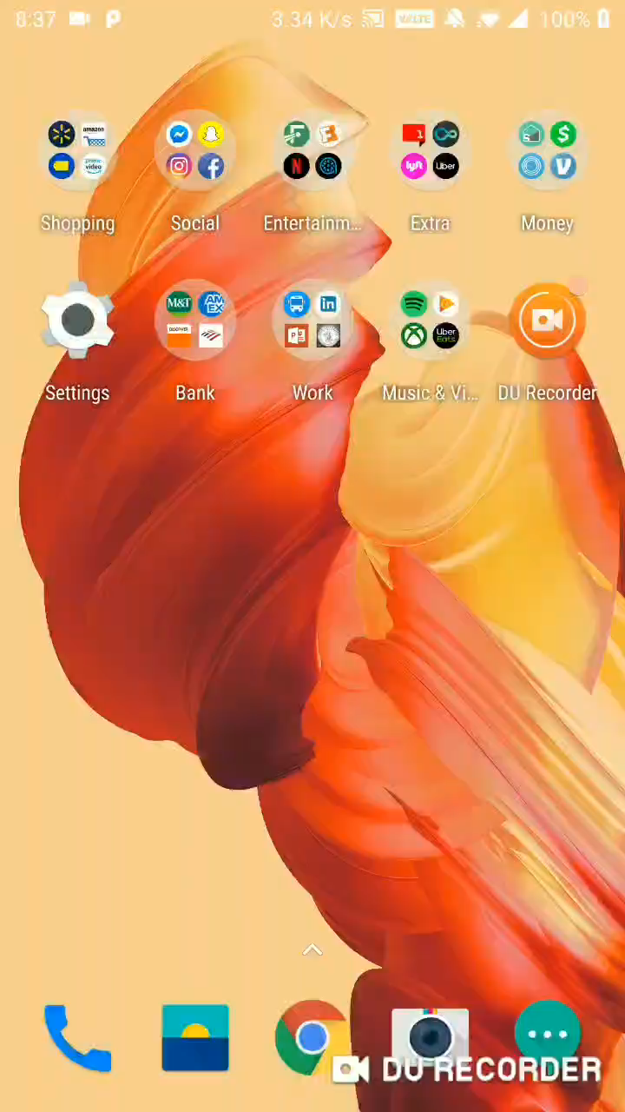
App Demo

Slide 22
Technology Used
Android studio 3.2.1
Sceneform 1.8.0
SWIFT
Deep Learning
SQLite

Slide 23
Architecture Diagram
Training Phase
Deep Convolutional Neural Network
extract
Images with label
training
Videos
Service Phase
Room level model for level area recognition
Sent
Input Photo
to model

Slide 24
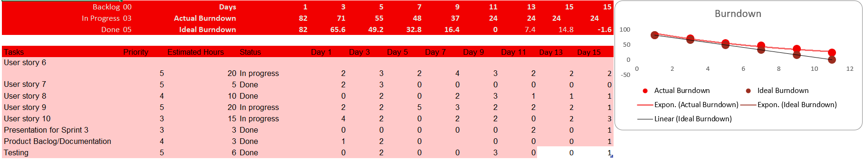
Burn Down Chart (SPRINT3)

Slide 25
THANK YOU

